Slide 1
Curriculum Reform
Toh Tin Lam
tinlam.toh@nie.edu.sg
National Institute of Education, Nanyang Technological University, Singapore

Slide 2
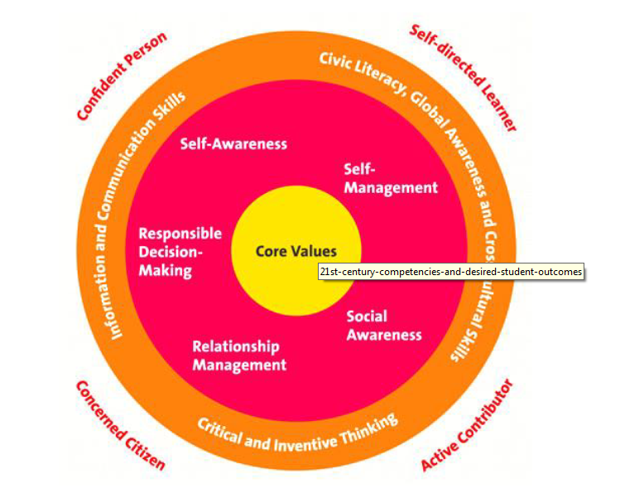
21st Century Competencies
Singapore Ministry of Education webpage

Slide 3
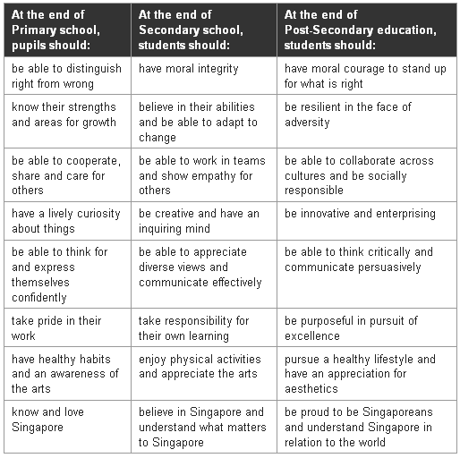
21st Century Competencies
Confident person
Self-directed learner
Active contributor
Concerned Citizen
Singapore Ministry of Education webpage

Slide 4
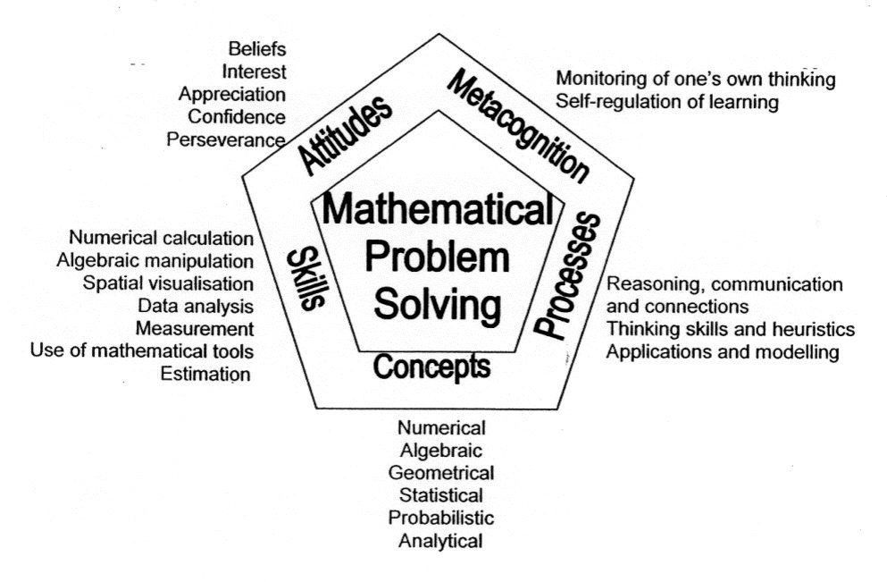
21st Century Competencies

Slide 5
Curriculum Reform
Some questions of curriculum reform:
How will each subject contribute to the 21st century competencies?
Less on subject discipline and more on global learning?

Slide 6
Curriculum Reform
Mathematics (Confident Person & Self-directed Learner)
Rigor
Back to basics
Technology

Slide 7
Curriculum Reform
Values that Mathematics can develop in an individual
Both hardware and software?

